Slide 1
Forecasting the volatility of a stock market index; A hybrid approach integrating a GARCH model into various ANNs
Elizabeth White

Slide 2
Outline of My Interim Presentation
Volatility and the importance of volatility forecasting in finance
Theoretical Background: GARCH, Feed-Forward Neural Nets and LSTMs and hybrid models
Literature Review
Central aim of this thesis
Dataset and Methodology
Key Findings of Results
Discussion of Results
Improvements and Potential Future Work

Slide 3
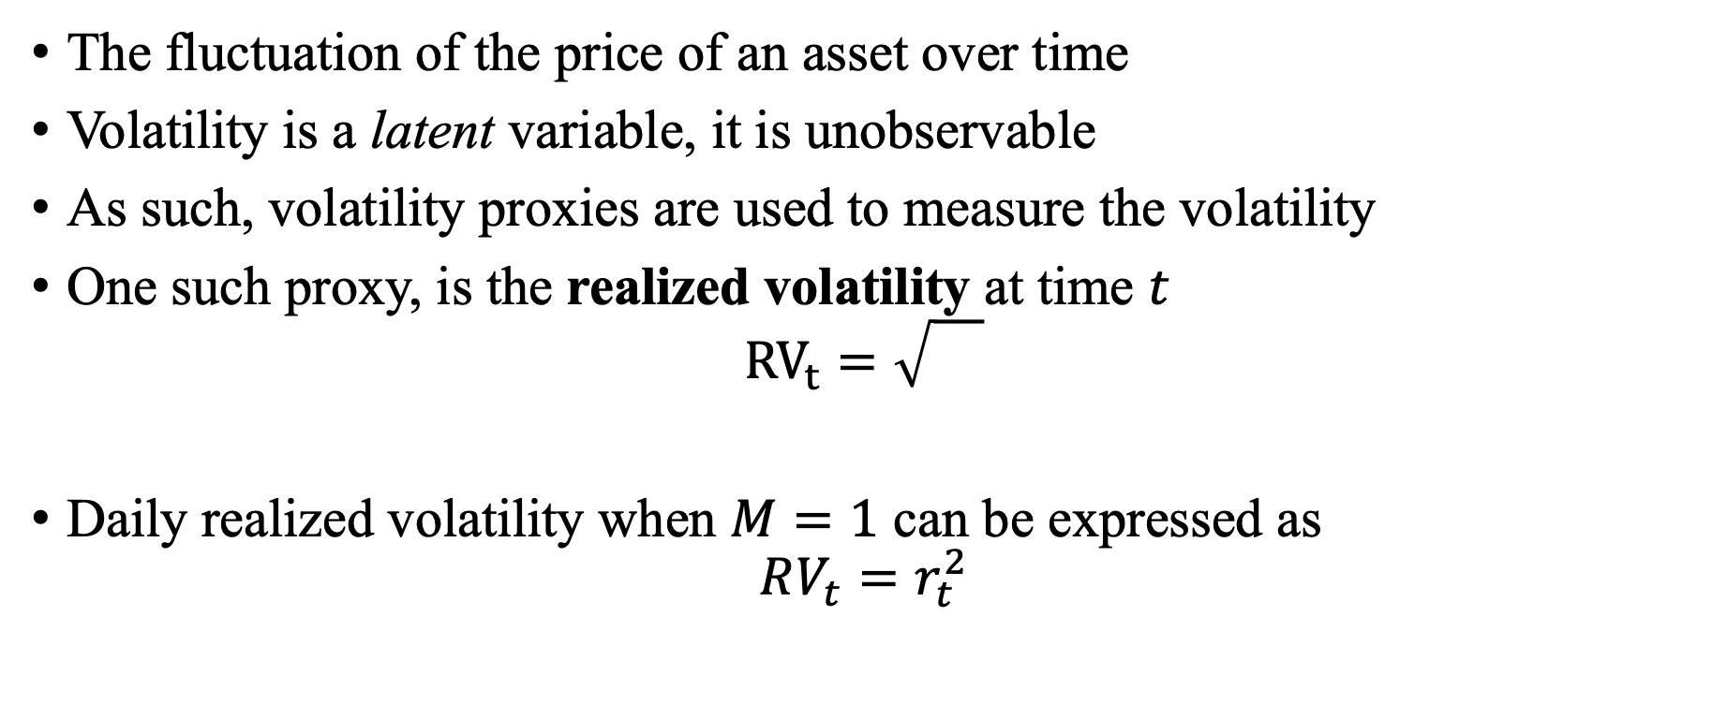
Volatility
The fluctuation of the price of an asset over time
Volatility is a latent variable, it is unobservable
As such, volatility proxies are used to measure the volatility
One such proxy, is the realized volatility at time $t$
$${RV}_{t}=\sqrt{}$$
Daily realized volatility when $M=1$ can be expressed as
$$RV_{t}=r_{t}^{2}$$

Slide 4
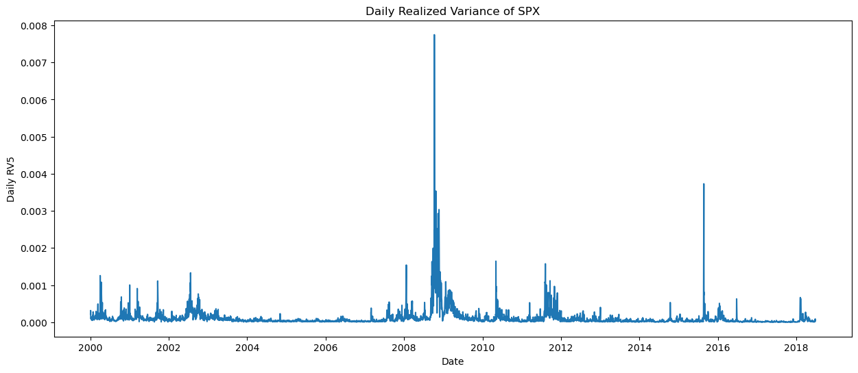
Why is volatility forecasting important?
Volatility forecasting in finance is important for numerous reasons
The challenges involved in forecasting realized volatility:
Models cannot account for external market conditions.
Models must account for stylized facts about volatility; e.g. volatility clustering
Periods of high volatility
Periods of low volatility
Figure: Volatility clustering seen in the daily realized volatility of the S&P 500
Notes:
Risk management – high volatility, move to lower vol assets
Option pricing – volatility is a key component in pricing of options

Slide 5
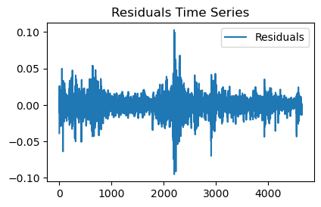
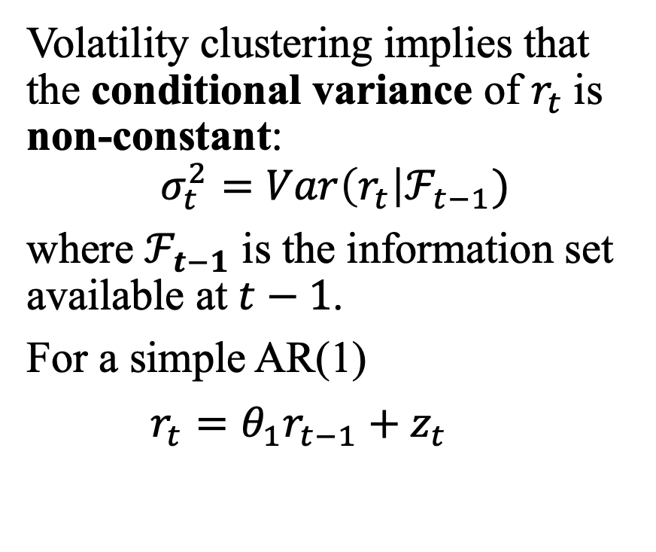
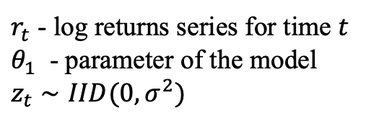
Volatility Clustering
Figure: Log return residuals when fitted of AR(1) model
Volatility clustering implies that the conditional variance of $r_{t}$is non-constant:
$$σ_{t}^{2}=Var\left(r_{t}\right|ℱ_{t−1})$$
where $ℱ_{t−1}$ is the information set available at $t−1$.
For a simple AR(1)
$r_{t}=θ_{1}r_{t−1}+z_{t}$
$r_{t}$ - log returns series for time $t$
$θ_{1}$ - parameter of the model
$z_{t}∼IID(0,σ^{2})$

Slide 6
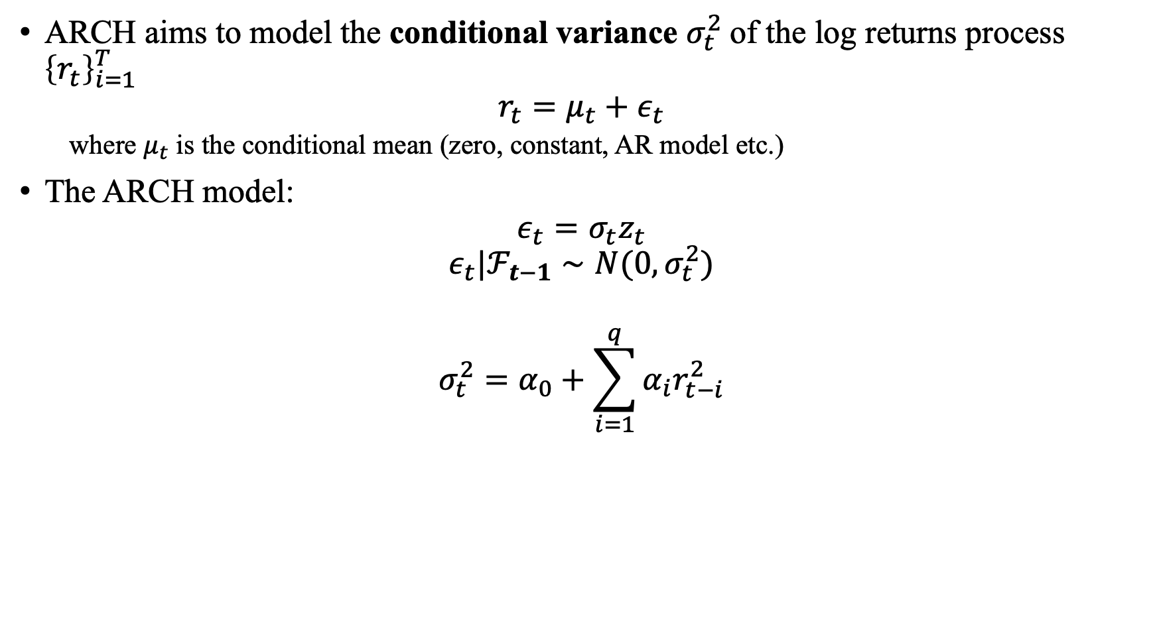

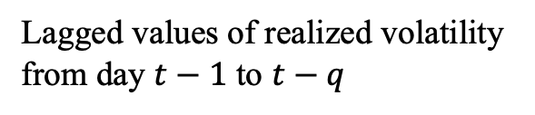

ARCH(q) Model (Engle, 1982)
ARCH aims to model the conditional variance $σ_{t}^{2}$of the log returns process ${\left\{r_{t}\right\}}_{i=1}^{T}$
$$r_{t}=μ_{t}+ε_{t}$$
where $μ_{t}$ is the conditional mean (zero, constant, AR model etc.)
The ARCH model:
$$ε_{t}=σ_{t}z_{t}$$
$$ε_{t}|ℱ_{t−1}∼N(0,σ_{t}^{2})$$
$$σ_{t}^{2}=α_{0}+\sum_{i=1}^{q}{α_{i}r_{t−i}^{2}}$$
$z_{t}∼N(0,1)$
$$α_{0}>0 , α_{i}≥0$$
Conditional variance on day $t$
Lagged values of realized volatility from day $t−1$ to $t−q$

Slide 7
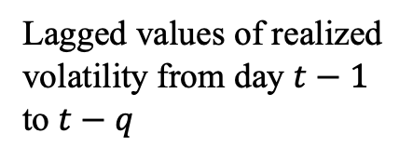
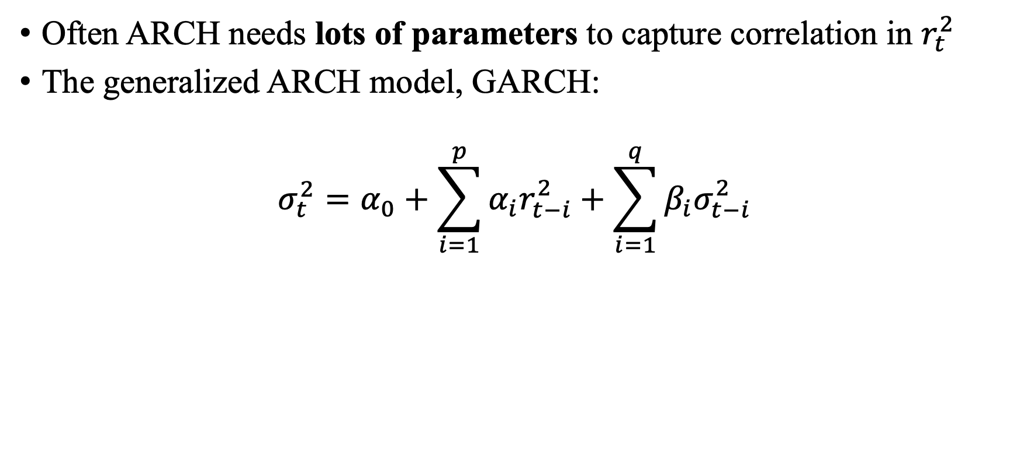

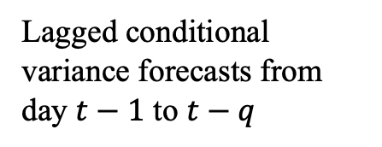
GARCH(p,q) Model (Bollerslev, 1986)
Often ARCH needs lots of parameters to capture correlation in $r_{t}^{2}$
The generalized ARCH model, GARCH:
$$σ_{t}^{2}=α_{0}+\sum_{i=1}^{p}{α_{i}r_{t−i}^{2}}+\sum_{i=1}^{q}{β_{i}σ_{t−i}^{2}}$$
Lagged conditional variance forecasts from day $t−1$ to $t−q$
Conditional variance on day $t$
Lagged values of realized volatility from day $t−1$ to $t−q$

Slide 8
Limitations of the GARCH Model
Limitations of the GARCH Model:
Volatility is very complex
Many exogenous variables affecting volatility
Unable to capture asymmetric impacts (“leverage effect”)
Negative correlation between returns and volatility
Model has limited flexibility and may struggle to capture complex dynamics within data

Slide 9
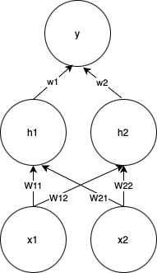
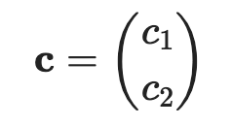
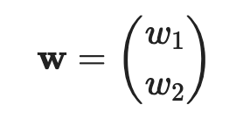

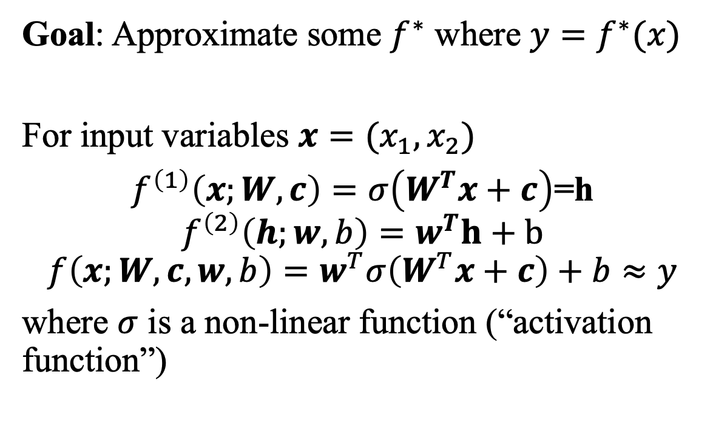
Neural Networks; Main Idea
Goal: Approximate some $f^{∗}$ where $y=f^{∗}(x)$
For input variables $x=(x_{1},x_{2})$
$f^{\left(1\right)}\left(x;W,c\right)=σ\left(W^{T}x+c\right)$=h
$$f^{\left(2\right)}\left(h;w,b\right)=w^{T}h+b$$
$$f\left(x;W,c,w,b\right)=w^{T}σ\left(W^{T}x+c\right)+b≈y$$
where $σ$ is a non-linear function (“activation function”)
Figure: Simple representation of feed-forward neural network with one hidden layer.
Notes:
Composition of f, each f has this form (at a basic level)

Slide 10
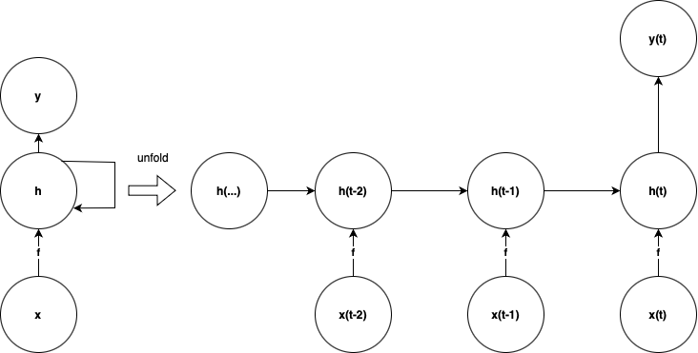
Why Long-Short Term Memory Models?
LSTMs are a type of Recurrent Neural Network
RNN able to handle sequential data
LSTMs are better suited to handle long term dependencies
Figure: Representation of RNN

Slide 11
Overview of Literature
1980s
ARCH model introduced
1990s
Research into the use of neural networks for volatility forecasting
2000s
GARCH models combined with artificial neural networks shown to outperform standalone model.
2018-Present
Evidence showing GARCH-LSTMs outperform standalone models for volatility forecasting
2010s
LSTMs shown to outperform feed-forward neural network
GARCH and various GARCH extensions introduced
Studies showed improved performance over GARCH

Slide 12
The Research Problem
Aim:
Main Questions & Contribution to Literature:
Validate that a GARCH-LSTM can outperform standalone models.
Evaluate performance of model when given a larger lookback window (252 days).
Evaluate the performance of GARCH, LSTM and a hybrid GARCH-LSTM model in forecasting the daily realized volatility of the S&P 500.

Slide 13
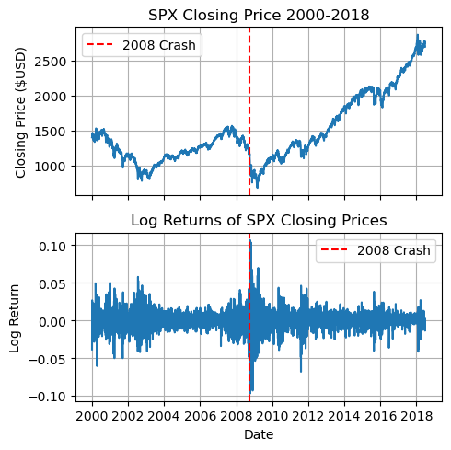
Dataset; Oxford Realized Library
Stock: S&P 500 (SPX)
Number of observations: 4641 days.
Time frame: 03/01/2001-27/06/2018.
Features: Daily Realized Volatility (5-min sampling frequency), Daily Close Price.
Features Engineering: Log Returns & Log Returns Squared.
Figure: Closing prices and log returns of SPX from dataset

Slide 14
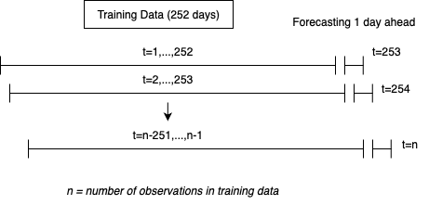
Rolling lookback windows
Figure: 252-day rolling window used to estimate parameters for GARCH and train neural networks.

Slide 15
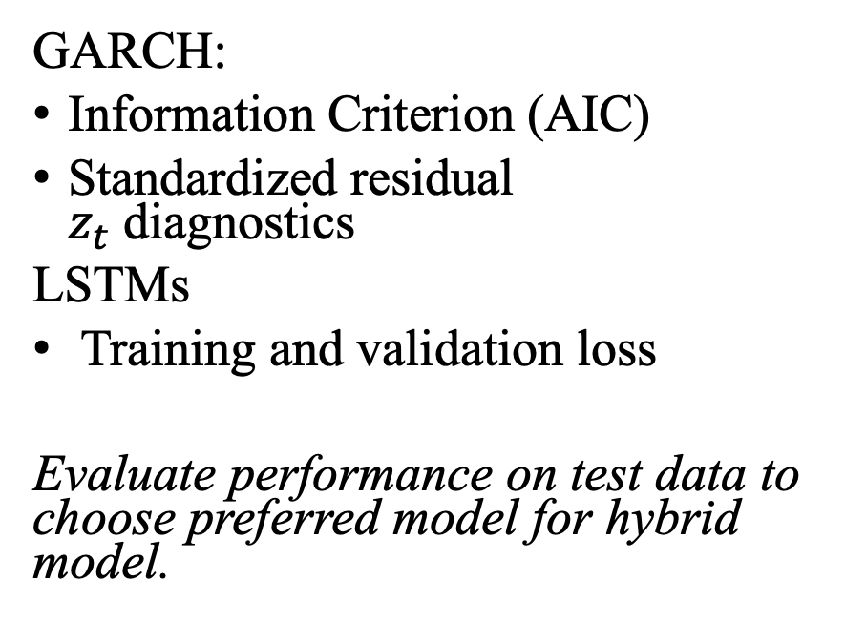
Evaluating Performance
In-Sample:
Out-of-sample:
GARCH:
Information Criterion (AIC)
Standardized residual $z_{t}$diagnostics
LSTMs
Training and validation loss
Evaluate performance on test data to choose preferred model for hybrid model.
Holdout 20% of data to test models on.
Compare daily forecasts of GARCH, LSTM and hybrid model
Error Metric | Rationale
MAE | Quantifies errors.
RMSE | RMSE more sensitive to outliers

Slide 16
GARCH Model:

Slide 17
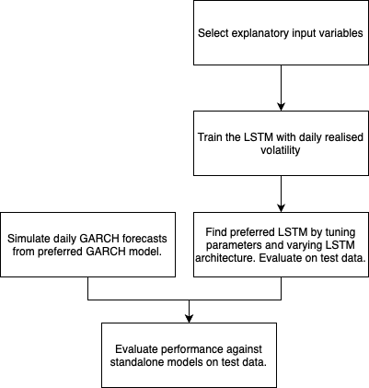
Hybrid GARCH-LSTM

Slide 18
Next Steps
Build simple GARCH, LSTM, GARCH-LSTM models and evaluate performance.
Assess performance of this model when varying rolling window size
Evaluate the performance of various LSTM architectures
Integrate additional explanatory variables and evaluate their significance

